Slide 1

Java Script

Slide 2

Server-side Applications vs. Client-side Applications
server-side applications are applications runs on the Web Server
Client-side applications are small applications which are embedded within the HTML code and executed by the browser.
Server-Side Code
Languages include Python , PHP, C#, Servlets and JSP;
Cannot be seen by the user .
Can only respond to HTTP requests
Client-Side Code
Languages used include: HTML, CSS, and Java script.
Parsed by the user’s browser.
Reacts to user input.

Slide 3
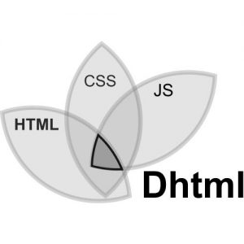
What is DHTML?
Dynamic HyperText Markup Language (DHTML) is a combination of Web development technologies used to create dynamically changing websites.
DHTML = HTML + CSS +JavaScript

Slide 4

What is JavaScript
JavaScript is a scripting language designed primarily for creating dynamic Web pages.
It is used to add dynamic behavior, store information, and handle requests and responses on a website
JavaScript is most commonly used as a client side scripting language. This means that JavaScript code is written into an HTML page.

Slide 5
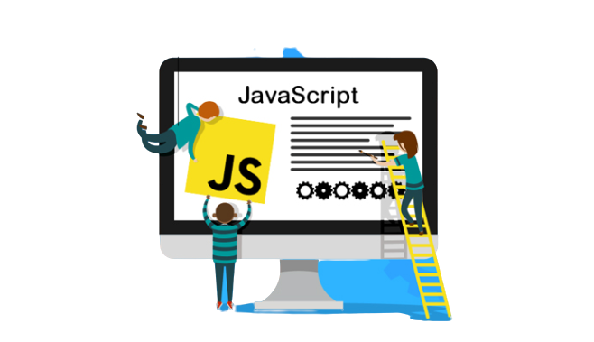
History of JavaScript ?
JavaScript was created by Brendan Eich in 1995 at Netscape Communications.
JavaScript was first known as LiveScript, but Netscape changed its name to JavaScript

Slide 6
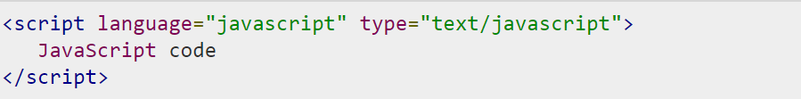
JavaScript - Syntax
JavaScript can be implemented using JavaScript statements that are placed within the <script>... </script>
You can place the <script> within the <head> tags.
The script tag takes two important attributes :
Language − This attribute specifies what scripting language you are using. Typically, its value will be javascript.
Type − The type attribute specifies the content in the script tag

Slide 7
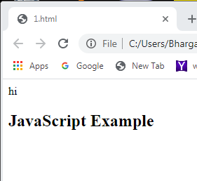
First JavaScript Program
<html>
<head>
<script>
document.write("hi");
</script>
</head>
<body>
<h2>JavaScript Example</h2>
</body>
</html>
document.write writes a string into HTML document.

Slide 8
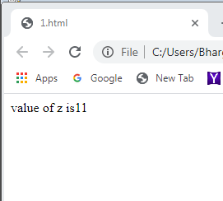
Variables in java script
Variables are used to hold data.
JavaScript is a case-sensitive language
Syntax:
var varname;
<body>
<script>
var x = 5;
var y = 6;
var z = x + y;
document.write("value of z is" +z);
</script>
</body> </html>

Slide 9
Functions
A function is some code that is executed when an event fires or a call to that function is made.
Typically a function contains several lines of code.
Functions are written in the <head> element.
Syntax
function function-name(parameter1, parameter2, parameter3)
{ code to be executed }

Slide 10
<html><head><script>
function add(){
var a,b,c;
a=Number(document.getElementById("first").value);
b=Number(document.getElementById("second").value);
c= a + b;
document.getElementById("answer").value= c;
}
</script></head><body>
Enter First Value:<input type="text" id="first"><br>
Enter second Value:<input type="text" id="second"><br>
Answer:<input id="answer"><br>
<button onclick="add()">Answer</button>
</body></html>

Slide 11
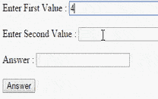

Slide 12
Built-in Objects in JavaScript
JavaScript supports a number of built-in objects that extend the flexibility of the language.
Javascript provides following built-in objects
Date
Math
Array
String

Slide 13
Date Object
The JavaScript date object can be used to get year, month and day.
Date objects are created with the new Date( )
Syntax
var obj=new Date();

Slide 14
Date Methods
Method | Description
getFullYear() | returns the year in 4 digit e.g. 2015.
getMonth() | returns the month in 2 digit from 0 to 11. So it is better to use getMonth()+1 in your code.
getDate() | returns the date in 1 or 2 digit from 1 to 31.
getDay() | returns the day of week in 1 digit from 0 to 6.
getHours() | returns the hour (0-23)
getMinutes() | Returns the minutes (0-59)
getSeconds() | returns the seconds (0-59)
getMilliseconds() | returns the milliseconds.
Method | Description
getFullYear() | returns the year in 4 digit e.g. 2015.
getMonth() | returns the month in 2 digit from 0 to 11. So it is better to use getMonth()+1 in your code.
getDate() | returns the date in 1 or 2 digit from 1 to 31.
getDay() | returns the day of week in 1 digit from 0 to 6.
getHours() | returns the hour (0-23)
getMinutes() | Returns the minutes (0-59)
getSeconds() | returns the seconds (0-59)
getMilliseconds() | returns the milliseconds.

Slide 15
<html><body>
<script>
var d,day,month,year,h,m,s;
d=new Date();
day=d.getDate();
month=d.getMonth()+1;
year=d.getFullYear();
document.write("<br>Date is: "+day+"/"+month+"/"+year);
h=d.getHours();
m=d.getMinutes();
s=d.getSeconds();
document.write("<br>"+h+":"+m+":"+s);
</script>
</body></html>

Slide 16
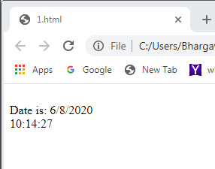

Slide 17

Math Object
The JavaScript math object provides several methods to perform mathematical operation.
Unlike date object, it doesn't have constructors.

Slide 18
Math Object Methods
Method | Description
abs() | Returns the absolute value of a number.
ceil() | Returns the integer greater than or equal to a number.
floor() | Returns the integer less than or equal to a number.
pow() | Returns base to the exponent power, that is, base exponent.
random() | Returns a random number between 0 and 1.
round() | Returns the value of a number rounded to the nearest integer.
sqrt() | Returns the square root of a number.

Slide 19
Example
<script>
document.write(Math.sqrt(4));
document.write("<br> Randam no is:" +Math.random());
document.write("<br> power is:"+ Math.pow(2,4));
document.write("<br> floor is:" +Math.floor(4.6));
document.write("<br> ceil is:"+Math.ceil(4.6));
document.write("<br> Round of no is:"+Math.round(4.6))
document.write("<br> absolute no is"+Math.abs(-4))
</script>

Slide 20
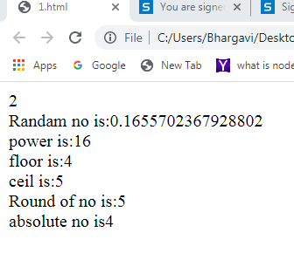

Slide 21

Array object
JavaScript array is an object that represents a collection of similar type of elements.
There are 3 ways to construct array in JavaScript
By array literal
By creating instance of Array directly (using new keyword)
By using an Array constructor (using new keyword)

Slide 22
1) JavaScript array literal
The syntax of creating array using array literal :
var arrayname=[value1,value2.....valueN];
Ex:
var emp=["Sonoo","Vimal","Ratan"];
for (i=0;i<emp.length;i++){
document.write(emp[i] + "<br/>");
}

Slide 23
2) JavaScript Array directly (new keyword)
The syntax of creating array directly is given below:
var arrayname=new Array();
Here, new keyword is used to create instance of array.
Example:
<script>
var i;
var emp = new Array();
emp[0] = "Arun";
emp[1] = "Varun";
emp[2] = "John";
for (i=0;i<emp.length;i++){
document.write(emp[i] + "<br>");
}
</script>

Slide 24
3) JavaScript array constructor (new keyword)
Here, you need to create instance of array by passing arguments in constructor so that we don't have to provide value explicitly.
Example:
<script>
var emp=new Array("Jai","Vijay","Smith");
for (i=0;i<emp.length;i++){
document.write(emp[i] + "<br>");
}
</script>

Slide 25
Javascript array length property returns the number of elements in an array.
Syntax:
array.length

Slide 26
Methods
Method | Description
concat() | Returns a new array comprised of this array joined with other array(s) and/or value(s).
pop() | Removes the last element from an array and returns that element.
push() | Adds one or more elements to the end of an array and returns the new length of the array.
reverse() | Reverses the order of the elements of an array -- the first becomes the last, and the last becomes the first.
shift() | Removes the first element from an array and returns that element.
slice() | Extracts a section of an array and returns a new array.
sort() | Sorts the elements of an array
unshift() | Adds one or more elements to the front of an array and returns the new length of the array.

Slide 27
<script>
var fruits = ["Banana", "Orange", "Apple", "Mango"];
document.write("<h1> Before Array operations:</h1>"+fruits);
fruits.pop();
document.write("<h1> After POP():</h1>"+fruits);
fruits.push("Kiwi");
document.write("<h1> After Push():</h1>"+fruits);
fruits.shift();
document.write("<h1> After shift():</h1>"+fruits);
fruits.unshift("Sapota");
document.write("<h1> After unshift():</h1>"+fruits);
var num=["2","1","3"]
var my= num.concat(fruits);
document.write("<h1> After concat():</h1>"+my);
document.write("<h1> After reverse:</h1>"+my.reverse());
document.write("<h1> After sort:</h1>"+my.sort());
</script>

Slide 28
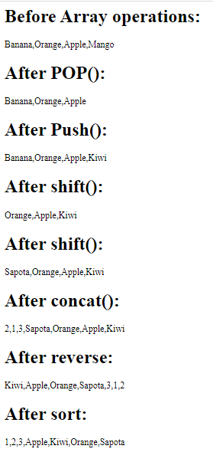

Slide 29
String Object
The JavaScript string is an object that represents a sequence of characters.
There are 2 ways to create string in JavaScript
By string literal
By string object (using new keyword)
1.string literal
The string literal is created using double quotes.
syntax:
var stringname="string value";
Ex:
<script>
var str="This is string literal";
document.write(str);
</script>

Slide 30
2)string object (using new keyword)
var stringname=new String("string literal");
Here, new keyword is used to create instance of string.
Ex:
<script>
var str=new String("hello javascript string");
document.write(stringname);
</script>

Slide 31
Methods
Method | Description
charAt() | Returns the character at the specified index.
concat() | Combines the text of two strings and returns a new string.
replace() | Used to find a match between a regular expression and a string, and to replace the matched substring with a new substring.
slice() | Extracts a section of a string and returns a new string.
substr() | Returns the characters in a string beginning at the specified location through the specified number of characters.
toLowerCase() | Returns the calling string value converted to lower case.
toString() | Returns a string representing the specified object.
toUpperCase() | Returns the calling string value converted to uppercase.

Slide 32
Example
<script>
var s1="javascript";
document.write("<h1>string length:</h1>"+s1.length);
document.write("<br>"+s1.charAt(2));
var s2="concat example";
var s3=s1.concat(s2);
document.write("<h1>after concat:</h1>"+s3);
var s4=s3.toUpperCase();
document.write("<h1>after Upper case:</h1>"+s4);
var s5=s4.toLowerCase();
document.write("<h1>after lower case:</h1>"+s5);
var s6=s5.slice(2,5);
document.write("<h1>after slice:</h1>"+s6);
var s7=s5.substr(2,5);
document.write("<h1>after substring:</h1>"+s7);
</script>

Slide 33
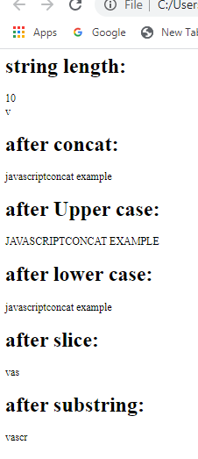

Slide 34
Window Object
The window object represents a window in browser.
An object of window is created automatically by the browser.
Method | Description
alert() | displays the alert box containing message with ok button.
confirm() | displays the confirm dialog box containing message with ok and cancel button.
prompt() | displays a dialog box to get input from the user.

Slide 35
Alert dialog box
It displays alert dialog box. It has message and ok button.
<html><head>
<script>
function msg(){
alert("Hello Alert Box");
}
</script></head> <body>
<input type="button" value="click" onclick="msg()">
</body></html>

Slide 36
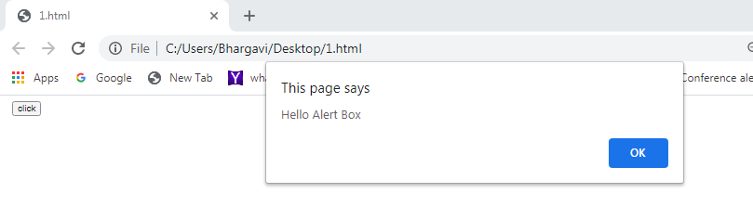

Slide 37
confirm() dialog box
It displays the confirm dialog box. It has message with ok and cancel buttons.
<html><head><script>
function msg(){
var v= confirm("Are u sure?");
if(v==true){
alert("ok");
}
else{
alert("cancel");
}
} </script> </head> <body>
<input type="button" value="deletrecord" onclick="msg()">
</body></html>

Slide 38
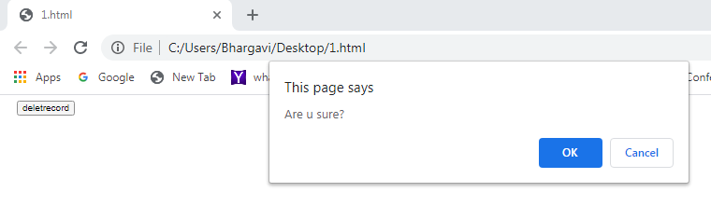
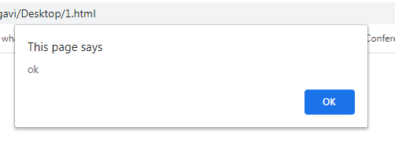

Slide 39
prompt dialog Box
It displays prompt dialog box for input. It has message and textfield.
<html><head><script>
function msg(){
var v= prompt("Who are you?");
alert("I am "+v);
}
</script> </head> <body>
<input type="button" value="click" onclick="msg()">
</body></html>

Slide 40
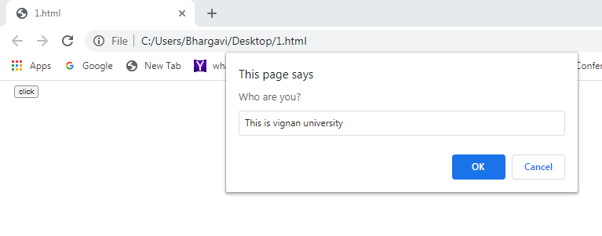
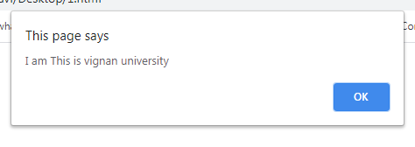

Slide 41
Document object
A Document object represents the HTML document that is displayed in that window.
Document object − Each HTML document that gets loaded into a window becomes a document object

Slide 42
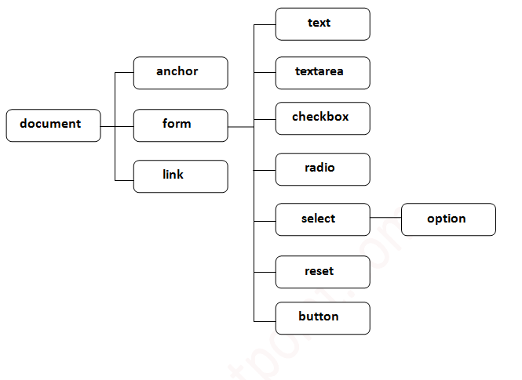

Slide 43
Methods of document object
Method | Description
write("string") | writes the given string on the document.
writeln("string") | writes the given string on the document with newline character at the end.
getElementById() | returns the element having the given id value.

Slide 44
Accessing field value by document object
document.form1.name.value is used to get the value of name field.
Here, document is the root element that represents the html document.
form1 is the name of the form.
name is the attribute name of the input text.
value is the property, that returns the value of the input text.

Slide 45
Example
<html><head><script>
function printvalue(){
var name=document.form1.name.value;
alert("Welcome: "+name);
}
</script> </head>
<form name="form1">
Enter Name:
<input type="text" name="name"/>
<input type="button" onclick="printvalue()" value="print name"/>
</form>
</html>

Slide 46
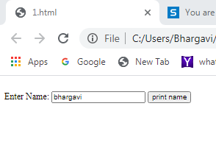
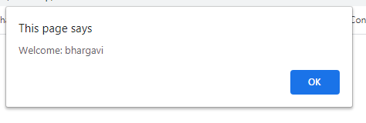

Slide 47
Data TyPES
Datatypes represents what type of data the variable is holding
There are two types of data types in JavaScript.
Primitive data type
Non-primitive (reference) data type

Slide 48
Primitive types
Data Type | Description
String | represents sequence of characters e.g. "hello"
Number | represents numeric values e.g. 100
Boolean | represents boolean value either false or true
Undefined | represents undefined value
Null | represents null i.e. no value at all

Slide 49
NON-Primitive types
Data Type | Description
Object | represents instance through which we can access members
Array | represents group of similar values
RegExp | represents regular expression

Slide 50
JavaScript is a dynamic type language, means you don't need to specify type of the variable because it is dynamically used by JavaScript engine
<script>
var x; // Now x is undefined
x = 5; // Now x is a Number
x = “Nehanth"; // Now x is a String
</script>

Slide 51
<script>
var carname = “Tata Nexon";
var x1 = 34.00;
var x = 5;
var y = 5;
var z = 6; (x == y) // Returns true (x == z) // Returns false
var cars = ["Safari",“Nexon","BMW"];
var person = {firstName:“joe", lastName:“sharma", age:50, eyeColor:"black"};
</script>

Slide 52
OPERATORS
Operator
Operator is all about performing some operation on single or multiple operands and getting a result.
Operators and Operands:
Operand Operator Operand
100 + 50

Slide 53
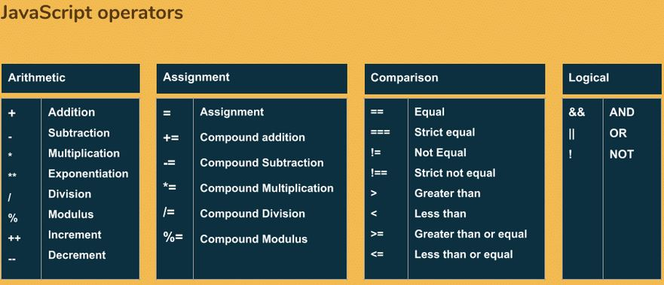

Slide 54
Bitwise operator:
Bitwise operators are used to changing individual bits in an operand. It works on 32 bits numbers.
& AND
| OR
~ NOT
^ XOR
<< Zero fill left shift
>> Signed right shift

Slide 55
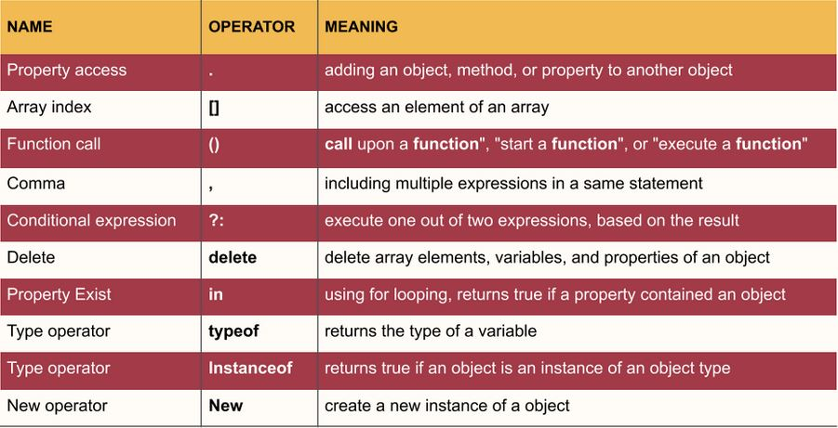
Special operators in js

Slide 56
Data Validation
Data validation is the process of ensuring that user input is clean, correct, and useful.
Typical validation tasks are:
has the user filled in all required fields?
has the user entered a valid date?
has the user entered text in a numeric field?
Most often, the purpose of data validation is to ensure correct user input.
Validation can be defined by many different methods, and deployed in many different ways.
Server side validation is performed by a web server, after input has been sent to the server.
Client side validation is performed by a web browser, before input is sent to a web server.

Slide 57
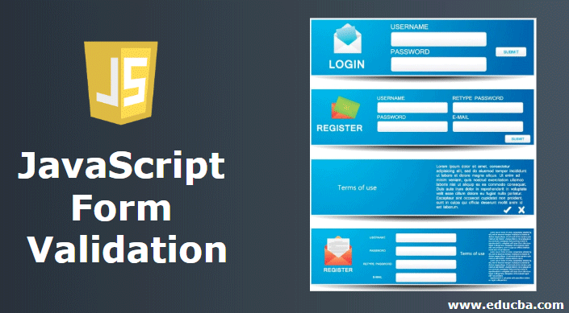
JavaScript Form Validation
Java script is a client side validation
What is form validation?
Form validation is the process of making sure that data supplied by the user using a form, meets the criteria set for collecting data from the user

Slide 58
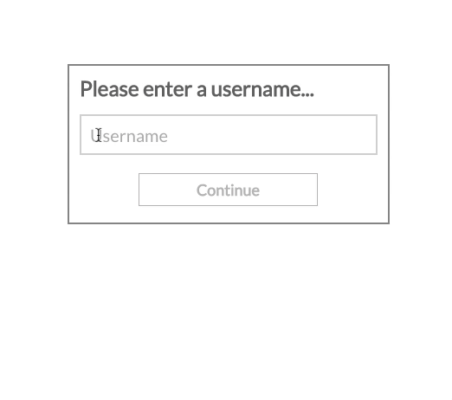
User Name Validation
Rules:
Name not empty
2. Only Characters.
3. Must be 5 to 15 Characters.

Slide 59
<html><head>
<script type="text/javascript">
function validation()
{
var a = document.form.name.value;
if(a=="")
{
alert("Please Enter Your Name");
return false;
}
if(!isNaN(a))
{
alert("Please Enter Only Characters");
return false;
}
if ((a.length < 5) || (a.length > 15))
{
alert("Your Character must be 5 to 15 Character");
return false;}}
</script></head>
<body>
<form name="form" method="post" onsubmit="return validation()">
Your Name:<input type="text" name="name"">
<input type="submit" name="sub" value="Submit">
</form></body></html>

Slide 60
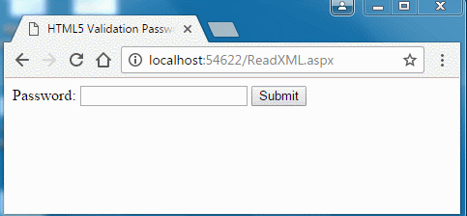
Password Validation
Rules:
6 to 20 characters which contain at least one numeric digit, one uppercase and one lowercase letter

Slide 61
<html> <head><script>
function CheckPassword()
{
input=document.form1.text1.value;
var pass= /^(?=.*\d)(?=.*[a-z])(?=.*[A-Z]).{6,20}$/;
if(input.match(pass))
{
alert("Correct")
return true;
}
else
{
alert('Wrong...!')
return false;
} }
</script> </head>
<body>
<h2>Input Password and Submit [6 to 20 characters which contain at least one numeric digit, one uppercase and one lowercase letter]</h2>
<form name="form1" action="#">
Enter Password <input type="text" name="text1"/>
<input type="submit" name="submit" value="Submit" onclick="CheckPassword()"/>
</form> </body> </html>

Slide 62
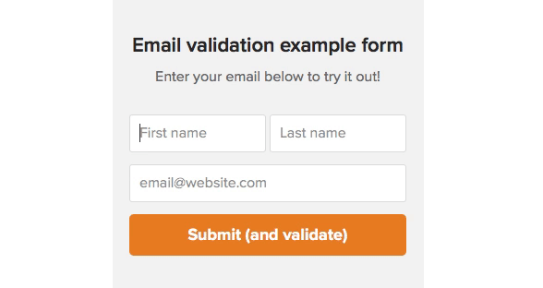
Email Validation
Must have @ and . characters
Word before and after @ then . After word with 2 to 3 characters.

Slide 63
<html> <head><script>
function CheckEmail()
{
input=document.form1.text1.value;
var email=/^\w+([\.-]?\w+)*@\w*(\.\w{2,3})$/;
if(input.match(email))
{
alert("Correct")
}
else
{
alert('Wrong...!')
} }
</script></head>
<body>
<form name="form1" action="#" onsubmit="CheckEmail()">
Enter EMail <input type="text" name="text1"/>
<input type="submit" name="submit" value="Submit" />
</form> </body> </html>

Slide 64
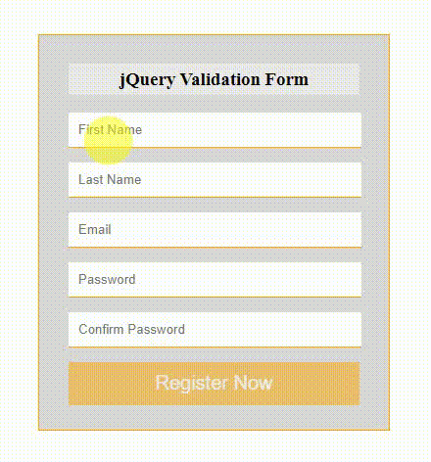

REGISTRATION FORM

